Slide 1
Digital Audio Signal Processing DASP Chapter-6: Sound Field Control
Jesper Brunnström - Marc Moonen
Dept. E.E./ESAT-STADIUS, KU Leuven
marc.moonen@kuleuven.be
homes.esat.kuleuven.be/~moonen/

Slide 2
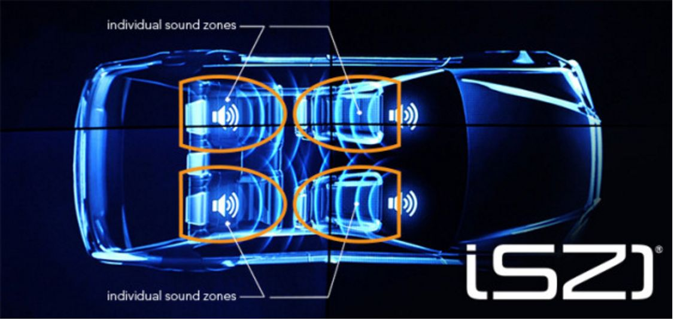
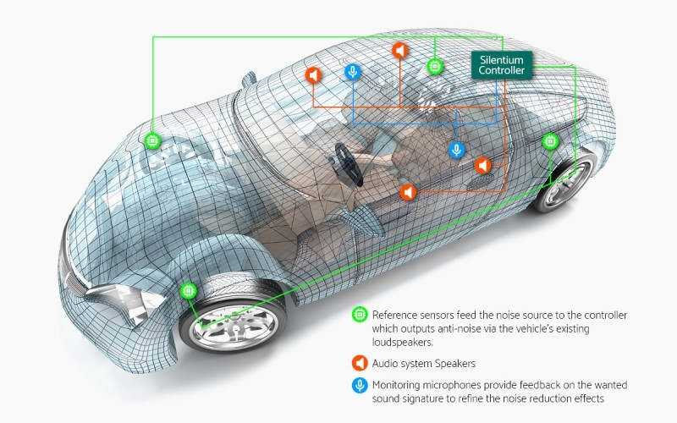
Sound field control - Outline
Basics
Signal Model
Sound zone control
Pressure Matching
Acoustic Contrast Control
Active noise control
Feedforward ANC
Filtered-x LMS
Feedback ANC
www.harman.com
www.silentium.com

Slide 3
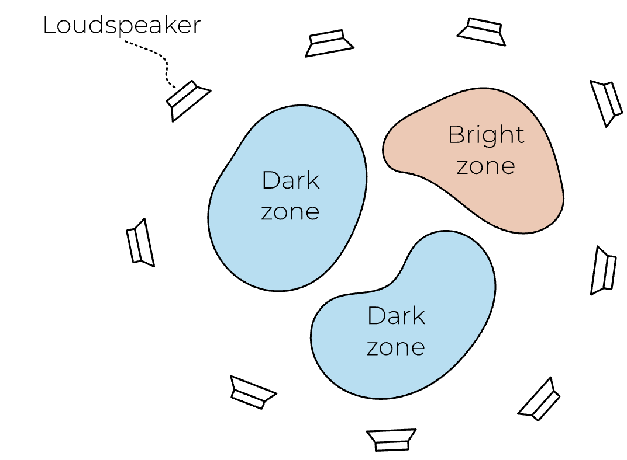
Basics
Design loudspeaker signal(s) from
reference signal(s), to control sound
at some point(s) in a room/space
Reference signal(s) either given
or recorded (microphone(s))
Requires knowledge of acoustic
impulses responses from each
loudspeaker to each control point (microphone)
Acoustic impulse responses may be measured
ahead of time (’calibration’)
Calibration can be a difficult in practice, time
consuming, or problematic if system is time-varying
Example: Binaural synthesis

Slide 4
Basics
…
…
virtual
sound source
Example: Binaural synthesis
…
…
Example: Sound field synthesis based on Huygens’ principle

Slide 5
Basics - Signal model
Sound pressure at a control point resulting from a single loudspeaker is..
Loudspeaker signal is reference/input signal filtered by control filter
Acoustic path
Loudspeaker signal
Acoustic path is generally modelled as a linear finite impulse response filter
Control filter
Reference signal

Slide 6
Basics - Signal model
Matrix form: w and h commute if time-invariant
= linear function of w

Slide 7
Sound field control - Outline
Basics
Signal Model
Sound zone control
Pressure Matching
Acoustic Contrast Control
Active noise control
Feedforward ANC
Filtered-x LMS
Feedback ANC
www.harman.com
www.silentium.com

Slide 8
Sound zone control – Problem statement
Reproduce different sounds for different listeners in the same room/space, with minimal interference
Can be viewed as ’transmit beamforming’ (vs. ’receive beamforming in Chapter 3-4)
Solve with superposition
Hence can consider problem with only a single input/reference signal, a single ’bright zone’, all other zones are ’dark zones’
Bright zone: Reproduce input signal Dark zone: Quiet
Other spaces: Any sound
Acoustic impulse responses from all loudspeakers to a dense set of control points (microphones) in all zones assumed given

Slide 9
Sound zone control – Signal model
One input signal x(n) (cfr. superposition)
One control filter per loudspeaker
One acoustic path from each loudspeaker to each control point (microphone)
ml
Sound pressure at m-th
control point (microphone)
Control filter for
l-th loudspeaker
Acoustic impulse response
from l-th loudspeaker to
m-th control point (microphone)

Slide 10
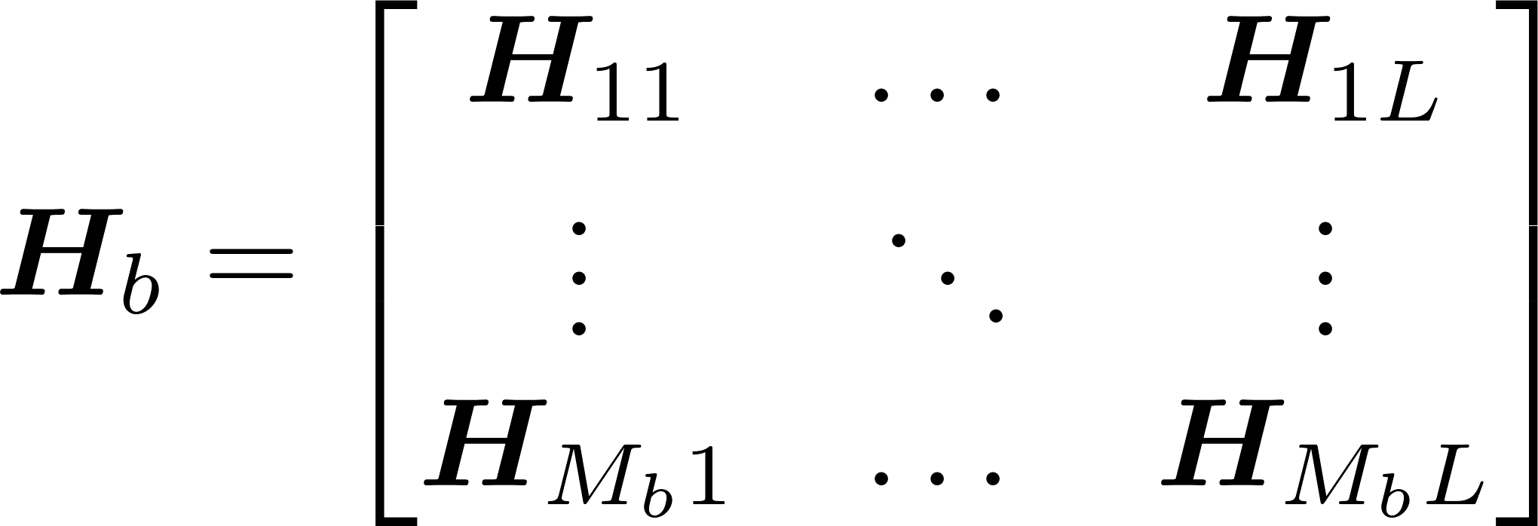
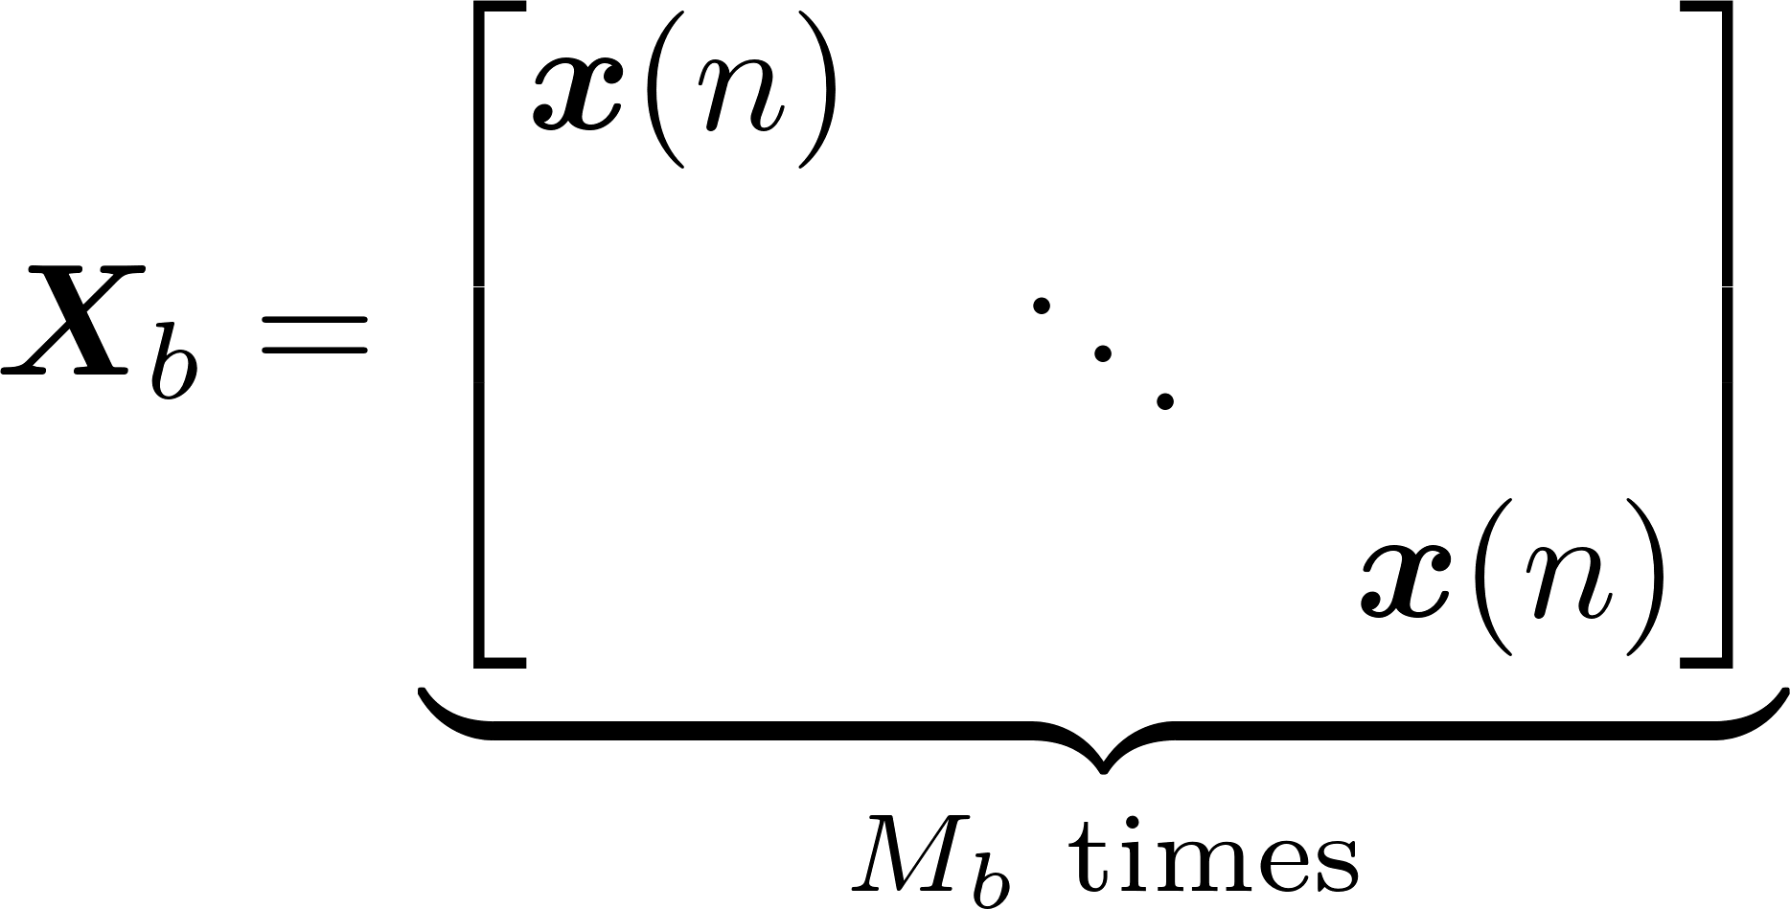
Sound zone control – Signal model
Matrix form:
T
T
Stack control filters for all loudspeakers
Acoustic paths from all (L) loudspeakers to all (M_{b}) microphones in bright zone
Block diagonal matrix with duplicated signal vectors
Sound pressure in M_{b} bright
zone microphones
Similarly:
Sound pressure in M_{d} dark
zone microphones

Slide 11
Sound zone control - Pressure Matching
Minimize the mean squared error (MSE) between the desired and reproduced signal
Desired signal in bright zone is usually input signal as reproduced by a virtual source
Desired signal in dark zones is 0
Optimal filters computed by setting gradient to zero...

Slide 12
Sound zone control - Pressure Matching
MSE-optimal control filters are
with
Correlation matrices are defined in terms of known signal and acoustic impulse responses, hence can be computed ahead of operation

Slide 13
Sound zone control - Pressure Matching
Same principles as for GEVD-based multichannel Wiener filter can be applied
Simultaneous diagonalization of matrix pair {R_{b},R_{d}} is
Skip this slide
then
T. Lee, J. K. Nielsen, J. R. Jensen, and M. G. Christensen, ‘A unified approach to generating sound zones using variable span linear filters’,
2018 IEEE International Conference on Acoustics, Speech and Signal Processing (ICASSP), Calgary, Canada, Apr. 2018, pp. 491–495.

Slide 14
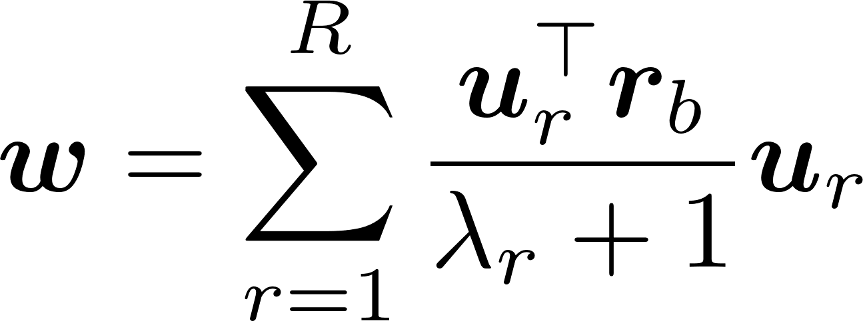
Sound zone control – Acoustic Contrast Control
Approximate with the R largest eigenvalues/eigenvectors
r-th column of U
r-th diagonal element of Λ
Trade-off...
- Full rank gives lowest error in the bright & dark zone (cfr. MSE)
- Rank-1 gives highest ’acoustic contrast’, i.e. ratio of signal
power in bright zone to signal power in dark zones (no proof)
Skip this slide
= Acoustic Contrast Control (ACC)
T. Lee, J. K. Nielsen, J. R. Jensen, and M. G. Christensen, ‘A unified approach to generating sound zones using variable span linear filters’,
2018 IEEE International Conference on Acoustics, Speech and Signal Processing (ICASSP), Calgary, Canada, Apr. 2018, pp. 491–495.

Slide 15
Sound field control - Outline
Basics
Signal Model
Sound zone control
Pressure Matching
Acoustic Contrast Control
Active noise control
Feedforward ANC
Filtered-x LMS
Feedback ANC
www.harman.com
www.silentium.com

Slide 16
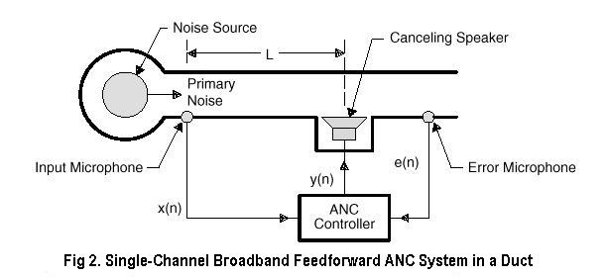
Active Noise Control - Intro
Passive noise control : sound absorbers, …
works well only for high frequencies (`centimeter-waves’)
Active noise control : for low frequencies (e.g. 100 Hz ➔ λ=3,4m)
General set-up
ANC works on the principle of destructive interference between the sound field generated by the `primary’ (noise) source and the sound field due to secondary source(s), whose output can be controlled
Aim: generate `quiet’
at error microphone

Slide 17
Active Noise Control - Intro
PS: Destructive interference relies on superposition & linearity
At higher volume, loudspeaker can exhibit non-linear behavour
After destructive interference at main frequency, harmonics
generated by loudspeaker may become distinctly audible
Non-linearity not considered here
PS: Destructive interference at
one point, may imply
constructive interference
at other point
Secondary source to be placed close to error microphone, so that only
modest secondary signal is required, and hence points further away
from secondary source are not affected. Produce `zone of quiet’ near
the error microphone (e.g. 10dB reduction in zone approx λ/10)

Slide 18
Feedforward ANC
d
Basic set-up
P(z) = primary path = unknown
H(z) = secondary path = acoustic path from loudspeaker (=secondary source) to error microphone.
H(z) can be modeled/identified (=calibration)
Secondary signal at error microphone is ideally equal to –d(n)
However (unlike in sound zoning): d(n) is not known/observed, only e(n) is observed…
P(z)
H(z)
primary
source
secondary
path
e
x
W(z)
y

Slide 19
Feedforward ANC
d
Basic set-up
(continued)
However (unlike in sound zoning): d(n) is not known/observed, only e(n) is observed…
Hence need adaptive filter controlled by e(n)
Design adaptive filter W(z) to minimize MSE (compare to AEC!)
P(z)
H(z)
primary
source
secondary
path
e
x
W(z)
y

Slide 20
Feedforward ANC
Signal model
Error microphone signal
Secondary signal
Primary (unwanted) signal
Reference signal is input to the control filter
(must be correlated with the primary signal)
See page 5
= correct if w & h are time-invariant
= approximation if w is (slowly)
time-varying (cfr infra)
Secondary path
Control
filter
Reference signal

Slide 21
Feedforward ANC
Minimize MSE cost function
2
Correlation between the error signal e(n)
and the reference signal x(n) filtered through the secondary path h, i.e.

Slide 22
Feedforward ANC – Filtered-x LMS
Gradient descent adaptive filter
Gradient is the direction in which the function increases fastest
Change the control filter in small steps in the opposite direction
Step size
Stochastic gradient adaptive filter
uses instantaneous estimate of gradient ( = LMS (Least Mean Squares))
This is referred to as ’Filtered-x LMS’
..as the input signal x(n) is first filtered by the secondary path h

Slide 23
PS: Interpretation
Straightforward application of LMS :
…does not work here
(ex.: H(z)=-1, then steepest descent turned into steepest ascent)
d
P(z)
H(z)
primary
source
secondary
path
e
x
W(z)
y

Slide 24
PS: Interpretation
This would have been a simpler problem (swap H and W)…
...allowing for straightforward application of LMS, with filtered x-signal
PS: Again, only time-invariant linear systems commute, hence (implicit) swapping will require slow adaptation of W(z)
d
x
P(z)
H(z)
e
W(z)
y

Slide 25
PS: Interpretation
Filtered-X LMS scheme : swapping of H and W only in adaptation path (not in filtering path)
…with in practice H’(z) an estimate of H(z)
d
P(z)
H(z)
x
e
W(z)
y
H’(z)
x

Slide 26
Feedforward ANC – Filtered-x LMS
Convergence is dependent on secondary path. Step size bounds assuming white reference signal [1]
hence (long) H(z) implies smaller μ & slower convergence
Stability also affected by the accuracy of secondary path estimate H’(z). Filtered-X LMS found to be robust to errors in H’(z)… (details omitted)
Note that adaptation in “first-H’(z)-then-W(z)” (as in p.24) relies on error signal (e) from “first-W(z)-then-H(z)”, which is inconsistent…
Power of filtered
reference signal
Length of control filter
Equivalent delay of secondary path
[1] I. Tabatabaei Ardekani and W. H. Abdulla, ‘Theoretical convergence analysis of FxLMS algorithm’, Signal Processing, vol. 90, no. 12, pp. 3046–3055, Dec. 2010,

Slide 27
Feedforward ANC – Filtered-x LMS
Improved version is ‘Modified Filtered-x LMS’
d
P(z)
+
+
H(z)
x
W(z)
+
-
y
H’(z)
copy
H’(z)
d’ (=estimate of d)
W(z)
e
x

Slide 28
Feedforward ANC – Filtered-x LMS
Improved version is ‘Modified Filtered-x LMS’
(continued)
Note that ( if H’(z)=H(z), hence d’=d ) adaptation in “first-H’(z)-then-W(z)” now relies on error signal (e) from “first-H’(z)-then-W(z)”, which is consistent
Hence improved convergence (can use larger step size)
Hence can also replace LMS by RLS (=‘Modified Filtered-x RLS’)

Slide 29
Feedforward ANC
Additional problem: Feedback (previously assumed to be negligible)
Feedback from secondary source (loudspeaker) into ref. microphone
This is an acoustic echo cancellation/feedback problem :
Fixed AFC based on given F(z) (obtained through calibration) is easy
Adaptive AFC is problematic (combination of 2 adaptive systems)
F(z)
d
H(z)
primary
source
secondary
source
x
e
Skip this slide
W(z)
y

Slide 30
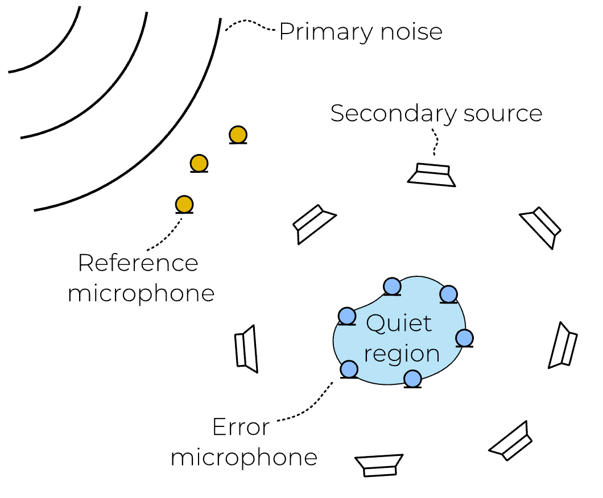
Feedforward ANC - MIMO
Extension:
Multiple reference signals
Multiple secondary sources
Multiple error signals
(a.k.a. ‘MIMO ANC’, multiple-input multiple-output ANC)
Applications: airplane/car cabin noise control, active vibration control,...
Needs generalization of Filtered-x algorithms, where coefficients of control filters are adapted to minimize the sum of the mean square values of all the error signals.

Slide 31
Feedforward ANC - MIMO
Loudspeaker signal is sum of contributions from all reference signals r
One control filter per ref.micr.-loudspeaker pair (R x L)
One secondary path per loudspeaker-error micr. pair (L x M)
Signal at microphone m is...
R reference microphones
L loudspeakers
M error microphones
ml

Slide 32
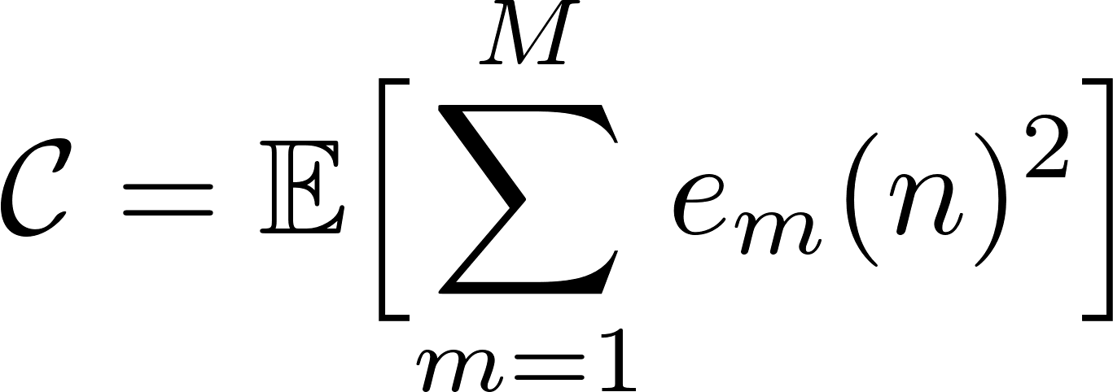
Feedforward ANC - MIMO
Minimize MSE (summed over error microphones)
Leads to MIMO Fx-LMS
Every reference signal is filtered by every secondary path
i.e. number of filtering operations is R x L x M (!)
If secondary paths are high-order FIR, leads to (extremely) high computational complexity

Slide 33
Feedback ANC
Basic set-up:
H(z) = secondary path
1 microphone instead of 2 microphones
Applications : active headsets, ear defenders
(e.g.10-15dB reduction achieved for frequencies 30-500Hz)
primary source
d
secondary source
H(z)
y
e
W(z)

Slide 34
Feedback ANC
Design problem:
If H(z) is given design W(z) (=feedback control) such that E(z) is `minimized’
For `flat’ H(z)=C^{nt} : W(z)=-A for large A (as in an opamp)
For general H(z) : see control courses
d
H(z)
+
y
e
W(z)

Slide 35
Feedback ANC
An interesting feedback controller is formed as follows :
…with H’(z) an estimate of H(z) and W(z) yet to be defined.
Note that if H’(z)=H(z), then W(z) is fed by d(n), i.e. …
d
H(z)
+
y
e
W(z)
+
-H’(z)

Slide 36
Feedback ANC
Note that if H’(z)=H(z), then W(z) is fed by d(n), i.e. …
…which means the feedback system has been
transformed into a feedforward system,..
d
H(z)
+
e
y
W(z)
d

Slide 37
Feedback ANC
In the set-up of p.18, this is …
With P(z) =1, and for instance for H(z) containing pure delay, this means W(z) must act as a predictor for d
Adaptation of W(z) based on (modified) filtered-X algorithm
d
1
H(z)
primary
source
secondary
path
e
x
W(z)
y

Slide 38
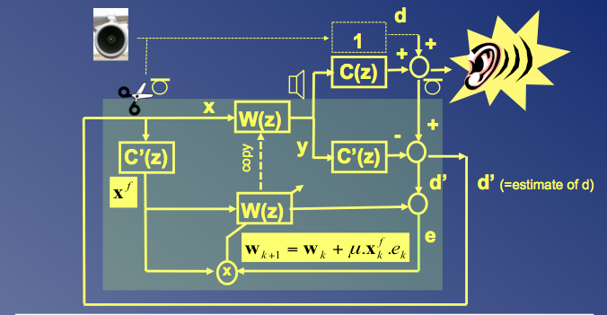
Feedback ANC
With H’(z)≠H(z) and modified Fx-LMS algorithm, this is...
Note that the error microphone signal (to the right) is used to replace the (non-existing) input (=noise reference) microphone signal (to the left). However, this error microphone signal has a contribution from the secondary loudspeaker signal (through C(z)), which is then as if the input microphone were affected by feedback (through C(z), see p15). The subtraction of the filtered loudspeaker signal (filtered by C’z) then also acts as a feedback cancellation.
H(z)
H’(z)
H’(z)
Compare to p.12 !

Slide 39
Feedback ANC
With H’(z)≠H(z) and modified Fx-LMS algorithm, this is...
Note that the error microphone signal (to the right) is used to replace the (non-existing) noise reference microphone signal (to the left)
However, this error microphone signal has a contribution from the secondary loudspeaker signal (through H(z)), which is then as if the input microphone were affected by feedback (through H(z))
The subtraction of the filtered loudspeaker signal (filtered by H’z) then also acts as a feedback cancellation.

Slide 40
Conclusion
Sound zone control
Considered fixed control filter design
Pressure Matching
Acoustic Contrast Control
Active noise control
Considered adaptive control filter design
Feedforward ANC
Feedback ANC
PS: Can also consider sound zoning with
adaptive control filters (how?)
www.harman.com
www.silentium.com

